Slide 1
Lecture 7 – Static Modeling of Entity Classes
COMP 3700: Modeling and Design
From Conceptual Static Model to Software System Context Class Diagram with Stereotypes
Gomaa, 2011

Slide 2
Steps for Designing Static Model
Construct the conceptual static model for the system
Build the hardware/software system context class diagram
Build the software system context class diagram
Add the external class stereotypes to the system software context class diagram

Slide 3
Participation Activity 5 & Preparation Activity 6: Peer-Review of Static Models
Remaining in in-class groups, peer review another group’s Static Model
Start from Use Case Model
Give feedback
Conceptual Static Model
Hardware/Software System Context Class Diagram
Software System Context Class Diagram
Write feedback directly on group artifacts
After you have given feedback, review the feedback your group received and iterate on your group’s Static Model
Upload your group’s updated Static Model to Canvas
Updated Conceptual Static Model
Hardware/Software System Context Class Diagram
Software System Context Class Diagram

Slide 4
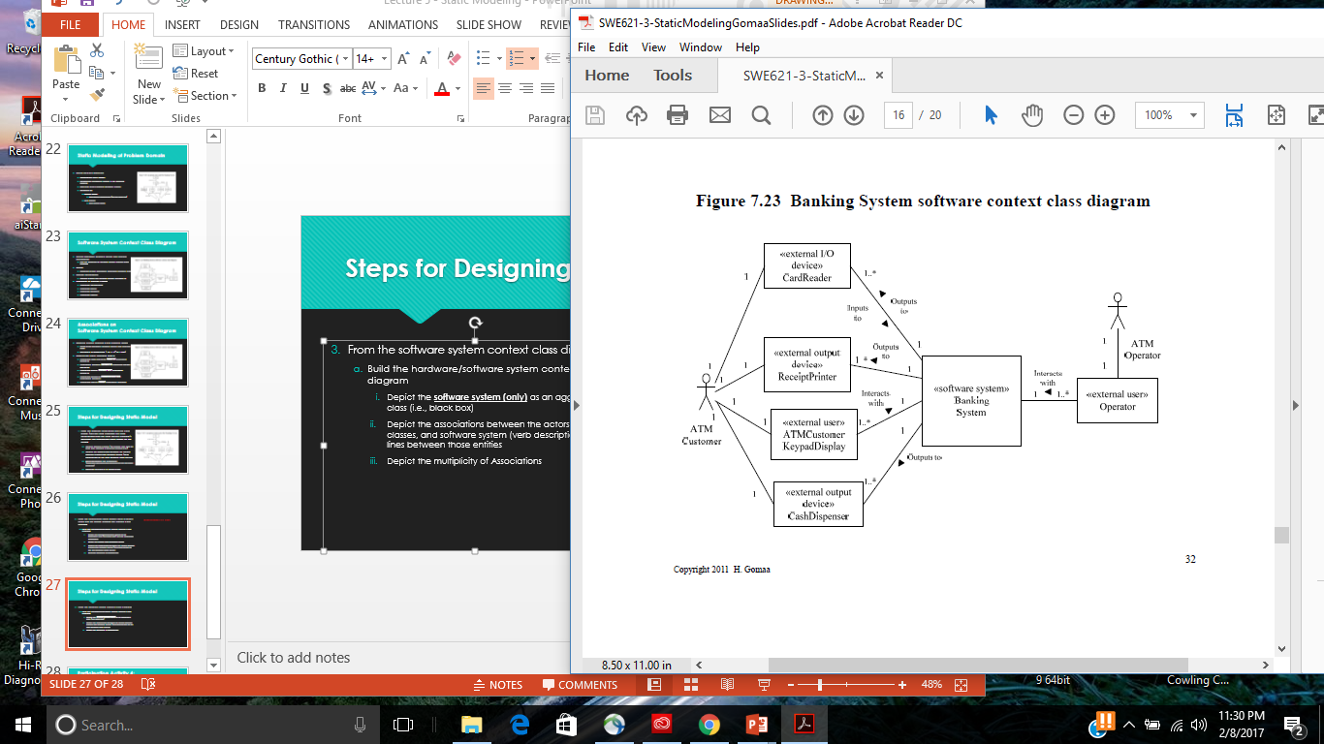
Entity Classes
Data intensive classes
Store long-living data (persistent)
Especially important for Information Systems
Many are database intensive
Also important for many real-time and distributed applications
COMET approach emphasizes static modeling of entity classes
During analysis modeling
Model entity classes in the problem domain
Attributes
Relationships

Slide 5
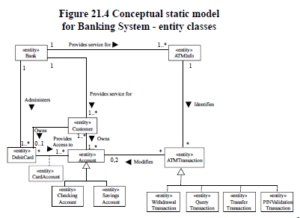
Moving into the Black Box
This phase focuses on understanding the problem domain/description from the perspective of the software
Understanding entities of the software that are likely not to change.
Start from the problem description
Identify static (i.e., unlikely to change) entities identified in the problem description
Model them as classes with the stereotype <<entity>>
Depict the associations between the entity classes (verb descriptions on the lines) between those classes
Depict the multiplicity of associations
For each class, describe attributes and attribute types using class UML notation

Slide 6
Moving into the Black Box
A bank has several automated teller machines (ATMs) that are geographically distributed and connected via a wide area network to a central server. Each ATM machine has a card reader, a cash dispenser, a keyboard/display, and a receipt printer. Using the ATM machine, a customer can withdraw cash from either a check or savings account, query the balance of the account, or transfer funds from one account to another.

Slide 7
Moving into the Black Box
A transaction is initiated when a customer inserts an ATM card (called DebitCard) into the card reader. Encoded on the magnetic strip on the back of the ATM card are the card number, the start date, and the expiration date. Assuming the card is recognized, the system validates the ATM card to determine the expiration date has not passed, that the user-entered personal identification number, or PIN, matches the PIN maintained by the system, and that the card is not lost or stolen. The customer is allowed three attempts to enter the correct PIN; the card is confiscated if the third attempt fails. Cards that have been reported lost or stolen are also confiscated.

Slide 8
Moving into the Black Box
If the PIN is validated satisfactorily, the customer is prompted for a withdrawal, query, or transfer transaction. Before a withdrawal can be approved, they system determines that sufficient funds exist in the requested account, that the maximum daily limit will not be exceeded, and that there are sufficient funds at the local cash dispenser. If the transaction is approved, the requested amount of cash is dispensed, a receipt is printed that contains information about the transaction, and the card is ejected.

Slide 9
Moving into the Black Box
Before a transfer transaction can be approved, the system determines that the customer has at least two accounts and that there are sufficient funds in the account to be debited. For approved query and transfer requests, a receipt is printed and the card ejected. A customer may cancel a transaction at any time; the transaction is terminated, and the card is ejected. Customer records, account records, and debit card records are all maintained at the server.

Slide 10
Moving into the Black Box
An ATM operator may start up and close down the ATM to replenish the ATM cash dispenser and for routine maintenance. It is assumed that functionality to open and close accounts and to create, update, and delete customer and debit card records is provided by an existing system and is not part of this problem.

Slide 11
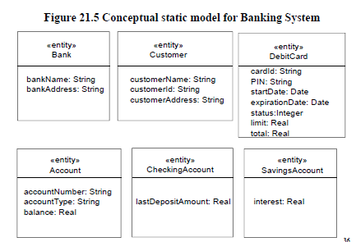
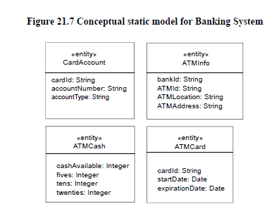
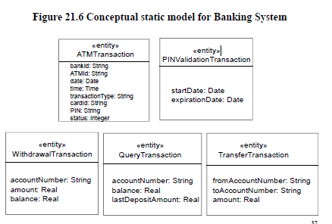
Moving into the Black Box

Slide 12
Participation Activity 6 Entity class diagram and class attributes
Remaining in in-class groups, create the entity class diagram for the software system depicted as a black box in your software context class diagram
Upload into Canvas
Entity class diagram with stereotypes
UML classes with class attributes (including types) with stereotypes
Reminder: Exam 2 is Thursday (2/23) in class

